Slide 1
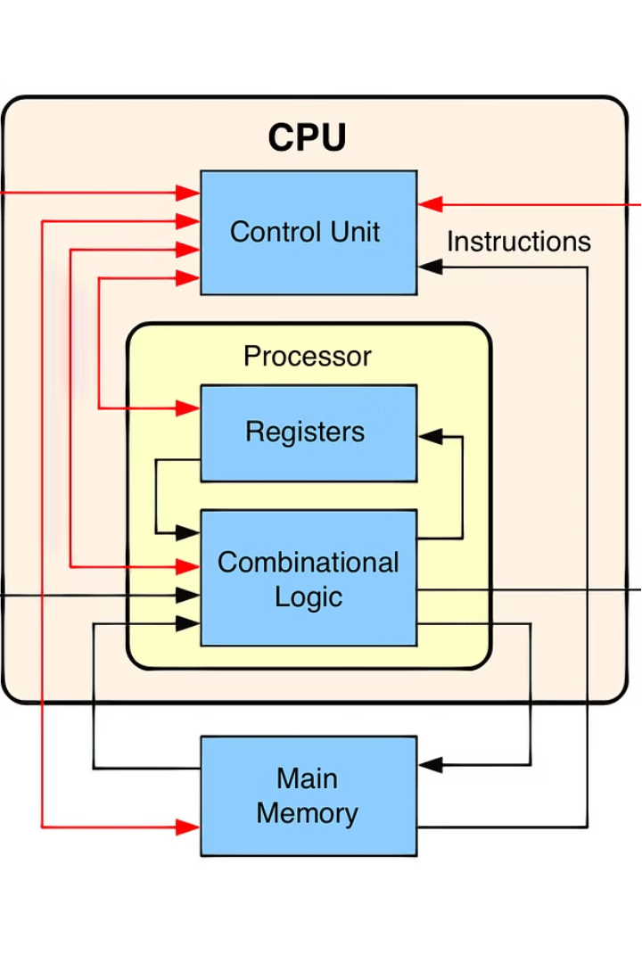
Division Algorithm
Division algorithms are fundamental operations in computer architecture, allowing processors to perform essential mathematical calculations. These algorithms enable efficient division of numbers, a crucial step in many computational processes, from simple arithmetic to advanced scientific computing.
by
K Nihar - 22B81A6231
Sai Teja – 22B81A6240
Harshith – 22B81A6258
CSE CS

Slide 2
Why Division Algorithm?
The division algorithm is a fundamental concept in mathematics, particularly in arithmetic and algebra. It provides a systematic way of dividing one number by another, allowing us to determine how many times one number (the divisor) can be subtracted from another number (the dividend) without resulting in a negative value.
Problem Solving: The division algorithm helps us solve problems involving the distribution or allocation of quantities
Fraction Representation: Division is crucial for representing fractions. When we divide one integer by another, we often get a fraction as a result
Algebraic Manipulations: In algebra, the division algorithm is used extensively for simplifying expressions, solving equations, and manipulating algebraic structures
Understanding Number Properties: Division helps us understand various properties of numbers, such as divisibility, prime factorization, and the relationship between different types of numbers

Slide 3
Fundamental Concepts of Division
Dividend
Quotient
The number to be divided.
The result of the division operation.
1
2
3
Divisor
The number by which the dividend is divided.

Slide 4

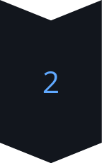
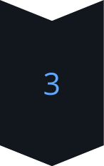
Non-Restoring Division Algorithm
Subtraction
The non-restoring division algorithm subtracts the divisor from the dividend, but does not restore the dividend after each iteration.
Bit Shift
The dividend is then shifted one bit to the right, effectively dividing it by 2.
Iteration
This process is repeated until the desired quotient is obtained, resulting in a more efficient algorithm compared to the restoring method.

Slide 5
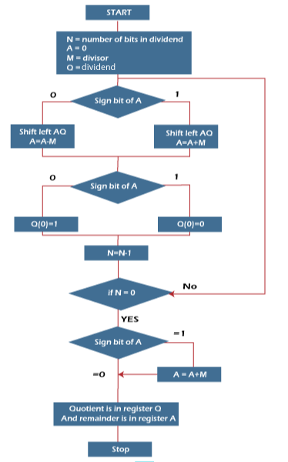
Non-Restoring Division Algorithm
N | M | A | Q | Action
4 | 00011 | 00000 | 1011 | Begin
 | 00011 | 00001 | 011_ | Shift left AQ
 | 00011 | 11110 | 011_ | A = A - M
3 | 00011 | 11110 | 0110 | Q[0] = 0
 | 00011 | 11100 | 110_ | Shift left AQ
 | 00011 | 11111 | 110_ | A = A + M
2 | 00011 | 11111 | 1100 | Q[0] = 0
 | 00011 | 11111 | 100_ | Shift left AQ
 | 00011 | 00010 | 100_ | A = A +M
1 | 00011 | 00010 | 1001 | Q[0] = 1
 | 00011 | 00101 | 001_ | Shift left AQ
 | 00011 | 00010 | 001_ | A = A - M
0 | 00011 | 00010 | 0011 | Q[0] = 1
So, register A contains the remainder 2, and register Q contains the quotient 3.

Slide 6
Restoring Division Algorithm
Step-by-Step Process
Advantages
Limitations
The restoring division algorithm involves a systematic approach of subtracting the divisor from the dividend, keeping track of the remainder, and iterating until the desired quotient is obtained.
This algorithm is straightforward to implement in hardware and provides a reliable method for division, making it a common choice in computer architecture.
The restoring division algorithm can be slower than other methods, particularly for large operands, due to the need to restore the dividend after each iteration.

Slide 7
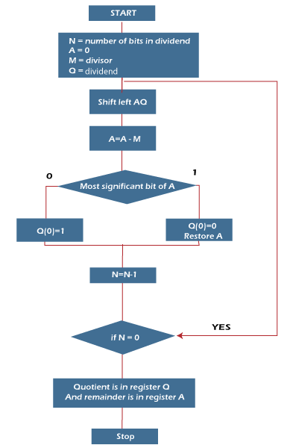
Restoring Division Algorithm
N | M | A | Q | Operation
4 | 00011 | 00000 | 1011 | Initialize
 | 00011 | 00001 | 011_ | Shift left AQ
 | 00011 | 11110 | 011_ | A = A - M
 | 00011 | 00001 | 0110 | Q[0] = 0 And restore A
3 | 00011 | 00010 | 110_ | Shift left AQ
 | 00011 | 11111 | 110_ | A = A - M
 | 00011 | 00010 | 1100 | Q[0] = 0
2 | 00011 | 00101 | 100_ | Shift left AQ
 | 00011 | 00010 | 100_ | A = A - M
 | 00011 | 00010 | 1001 | Q[0] = 1
1 | 00011 | 00101 | 001_ | Shift left AQ
 | 00011 | 00010 | 001_ | A = A - M
 | 00011 | 00010 | 0011 | Q[0] = 1

Slide 8
Conclusion and Applications
Arithmetic Operations
Division algorithms are essential for performing fundamental arithmetic operations in computer systems.
Scientific Calculations
Accurate division is crucial for scientific and engineering computations, such as those involving fractions and decimals.
Computer Graphics
Division is used in various computer graphics algorithms, such as perspective transformation and texture mapping.

Slide 9
Thank You

